Slide 1

DATA MINING · WEEK 10 GROUP PROJECT
Min-Apriori for Quantitative
Association Rule Mining
Dataset 1 · Retail Market Basket Analysis (Discrete Quantities)
min_sup = 3 · 5 transactions · 5 items · 12 rules generated Hantz 1113534 / Max 1113535

Slide 2


Why Min-Apriori?
Classical Apriori discards magnitude — Min-Apriori preserves it.
Classical Apriori (binary)
Min-Apriori (quantitative)
Sees only presence/absence:
Bounds joint signal by the weakest member:
Espresso × 5, Croissant × 1 → {1, 1}
Espresso × 5, Croissant × 1 → min = 1
· A 5-espresso run looks identical to a 1-espresso run.
· Co-occurrence intensity is lost.
· Combo offers built on this miss volume signals.
· Joint support reflects matched, balanced co-purchase.
· Magnitude carries through to confidence.
· Surfaces actionable bundles for combo design.
Min-Apriori · Dataset 1: Retail Market Basket
2 / 11

Slide 3

The Algorithm in Three Formulas
Min-Apriori = Apriori with the min bounding function.
1. 1-ITEMSET SUPPORT
2. k-ITEMSET SUPPORT
3. CONFIDENCE
Sup({i}) = Σₜ wₜ,ᵢ
Sup({i₁…iₖ}) = Σₜ min(wₜ,ᵢ₁ , … , wₜ,ᵢₖ)
Conf(A → B) = Sup(A ∪ B) / Sup(A)
Sum of the column across transactions.
Per transaction, take the minimum across the items, then sum.
Standard ratio — the directional metric for rule strength.
Apriori property still holds. For S' ⊆ S, min over fewer items can only be ≥ min over more, so Sup(S') ≥ Sup(S). This justifies (k−1)-subset pruning.
Min-Apriori · Dataset 1: Retail Market Basket
3 / 11

Slide 4
Algorithm Flow
Level-wise: each pass either grows the frequent set or terminates.
1
2
3
4
5
6
Data Prep
Init min_sup
L₁ Itemsets
C₂ → L₂
Cₖ → Lₖ
Rule Gen
Discrete: skip
Continuous: L₁ norm
Pruning threshold
(here: 3)
Column sums
≥ min_sup
Min per txn,
then sum
Iterate &
Apriori-prune
Confidence
A → B
↻ iterate & prune ↻
■ Setup steps ■ Iterative core ■ Output stage
Min-Apriori · Dataset 1: Retail Market Basket
4 / 11

Slide 5
The Dataset
Five customer baskets at a bakery & coffee shop · cells = quantity purchased.
 | Espresso | Croissant | Muffin | Latte | Tea
T1 | 2 | 2 | 0 | 0 | 1
T2 | 0 | 1 | 3 | 2 | 0
T3 | 1 | 2 | 0 | 1 | 2
T4 | 3 | 0 | 2 | 0 | 1
T5 | 2 | 3 | 1 | 1 | 0
PER-ITEM TOTALS
Espresso
8
Croissant
8
Muffin
6
Latte
4
Tea
4
Min-Apriori · Dataset 1: Retail Market Basket
5 / 11

Slide 6
Step 3 · Frequent 1-Itemsets (L₁)
Sum each column; retain those with support ≥ 3.
ALL 5 ITEMS PASS
5 / 5
survive the min_sup = 3 cut.
L₁ = { Espresso, Croissant, Muffin, Latte, Tea }
Min-Apriori · Dataset 1: Retail Market Basket
6 / 11

Slide 7
Step 4 · Frequent 2-Itemsets (L₂)
Per transaction, take the min across the pair; sum across transactions.
WORKED EXAMPLE
{ Espresso, Croissant }
Txn | min(Esp, Cro) | value
T1 | min(2, 2) | 2
T2 | min(0, 1) | 0
T3 | min(1, 2) | 1
T4 | min(3, 0) | 0
T5 | min(2, 3) | 2
Sup = 2 + 0 + 1 + 0 + 2 = 5 ✓ ≥ 3
Min-Apriori · Dataset 1: Retail Market Basket
7 / 11

Slide 8
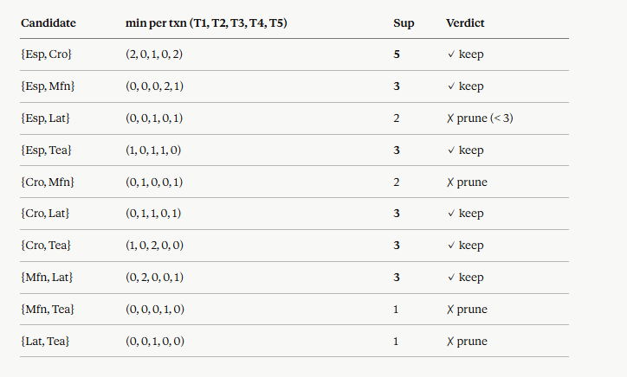

Slide 9
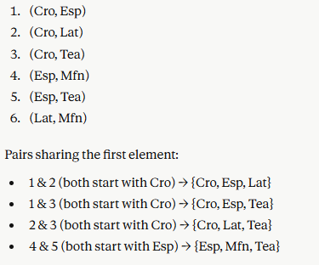
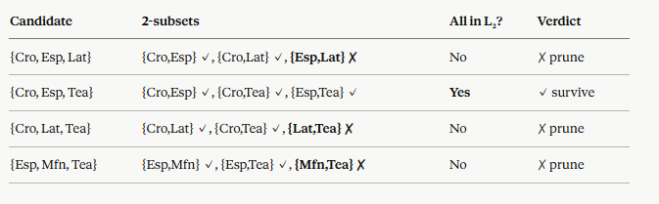

Slide 10

Step 5 · Higher Orders (L₃ = ∅)
Apriori-prune kills almost everything; the lone survivor fails the support test.
Apriori pruning
FAILS THE SUPPORT TEST
Any candidate {X, Y, Z} is pruned if any of its 2-subsets is missing from L₂.
{ Espresso, Croissant, Tea }
Sup = min(2,2,1) + min(0,1,0)
+ min(1,2,2) + min(3,0,1)
+ min(2,3,0)
= 1 + 0 + 1 + 0 + 0
= 2 < 3 ✗
Example: {Espresso, Muffin, Latte}
✗ pruned — {Espresso, Latte} ∉ L₂
Sole survivor of pruning:
{ Espresso, Croissant, Tea }
L₃ = ∅ → algorithm terminates.
Min-Apriori · Dataset 1: Retail Market Basket
8 / 11

Slide 11
Two Highlighted Rules
One picked for largest joint support, one for highest confidence — different stories.
RULE R1 · largest joint support
RULE R2 · highest confidence tier
{ Espresso } → { Croissant }
{ Latte } → { Muffin }
62.5%
75.0%
conf = Sup({E, C}) / Sup({E}) = 5 / 8
conf = Sup({L, M}) / Sup({L}) = 3 / 4
Classic breakfast pairing — bought together in matched quantities, suggesting per-person co-purchase.
Fewer Latte buyers than Espresso buyers — but the ones who do are very reliably also buying Muffins.
Min-Apriori · Dataset 1: Retail Market Basket
9 / 11

Slide 12
Min-Apriori vs Classical Apriori
Same dataset, same rules — Min-Apriori rewards quantity-balanced co-occurrence.
Rule | Min-Apriori | Classical | Δ
{Espresso} → {Croissant} | 62.5% | 62.5% | —
{Latte} → {Muffin} | 75.0% | 66.7% | +8.3 pp
{Tea} → {Croissant} | 75.0% | 66.7% | +8.3 pp
{Tea} → {Espresso} | 75.0% | 66.7% | +8.3 pp
WHEN THEY DIVERGE
Min-Apriori reports higher confidence whenever co-occurring items appear in matched, significant quantities — not just any joint presence.
Better signal for combo-offer design.
Why does {Espresso} → {Croissant} agree? Espresso always co-occurs with comparable Croissant quantities, so the binary projection loses no information here.
Min-Apriori · Dataset 1: Retail Market Basket
10 / 11

Slide 13
Takeaways
Min-Apriori on Dataset 1 · in three sentences.
1
2
3
Algorithm worked as designed
The min function is the whole idea
Methodology earns its keep
L₁ = 5 items, L₂ = 6 pairs, L₃ = ∅, 12 rules generated. Manual derivation matches the function output exactly.
Quantitative co-occurrence is bounded by the weakest member. Items bought together in matched amounts get rewarded.
On rules where binary projection loses information, Min-Apriori adds 8.3 pp of confidence — a real difference for combo-offer design.
Thank you · questions?

